Slide 1
Training Schedule
WEEK 1
Intro to property insurance and Exposure Data
WEEK 2
WEEK 3
Basic intro to cat models and there applications
WEEK 4
Continue modeling the data for the project
Slip interpretation of different line of business
Assessment

Slide 2
Agenda
Defining Insurance – What is It and Why do People Get It?
Types of Insurance and Parties Involved
Lines of Businesses
Terms
Coverages
Personal Lines vs Commercial Lines
Raw Data – Different Shapes and Sizes
Basic Policy Info
Geographic Data
Primary / Secondary Risk Characteristics
Notes:
In this session we are going to discuss in detail overview of insurance concepts, including definitions, types of insurance, policy terms, coverages, and risk characteristics If you are unclear Ask lots of follow-up questions, challenge each other, and arrive at the best possible idea.

Slide 3

Definition
Insurance is a Contract used to Alleviate Financial Risk
“A practice or arrangement by which a company or government agency provides a guarantee of compensation for specified loss, damage, illness, or death in return for payment of a premium.”
Essentially insurance is a means for individuals to pool money together in order to reduce financial risk following an unexpected event.
The policyholder pays an insurance company a small amount – usually monthly – so that if the policyholder incurs a relevant claim, the insurance company is liable for a portion of the bill.
Notes:
Insurance is a contract where an individual (policyholder) pays a premium to an insurance company in exchange for financial protection against specified risks.

Slide 4
Types of Insurance
Health Insurance
Policyholder is covered in the event of a medical emergency
Life Insurance
Beneficiaries are covered in the event of the policyholder’s death
Disability Insurance
Policyholder is covered for lost income due to injury or illness that prevents them from working
Property Insurance
Policyholder is covered in the event of damage to living space and/or contents
Auto Insurance
Policyholder is covered in the event of damage to automobile
Our Focus

Slide 5
Policy Terms – Property Insurance
Policy
The contract between the policyholder and insurance company
Location
The actual location(s) of the insured entity
Premium
The price the policyholder pays in exchange for insurance coverage
Claim
Any request or demand for payment under the terms of the insurance policy
Deductible
The potion of a claim the policyholder pays out of pocket
AOP (All Other Perils)
Policies usually have separate deductibles for Hurricane coverage and All Other Peril coverages

Slide 6
Policy Terms – Property Insurance (cont.)
Total Insured Value (TIV)
Cost of replacing the entire insured property
Total Replacement Value (TRV)
Typically the same as TIV, although some clients may report like a PARTOF
Coverage
Protection and benefits provided in an insurance contract
Insured Limit
The maximum amount of money an insurer will pay toward a covered claim
Loss
Ground Up Loss
Total Loss
Gross Loss
Total Loss less Insured Deductibles

Slide 7
Policy Terms – Property Insurance (cont.)
Inception Date
The date at which the insurance policy goes into effect
Expiration Date
The date that a policyholder’s insurance coverage ends
Blanket / Site Deductibles
Applies deductibles to a policy’s entire limit
Coverage Deductibles
Applies deductibles to certain coverages
Sublimit
Extra limitations in an insurance policy's coverage of certain losses

Slide 8
Coverages
Coverage A – Building Coverage
Applies to structural components of your home: walls, floors, ceiling, etc.
Coverage B – Other Structures Coverage
Applies to structures independent of your home: fencing, detached garages, etc.
Coverage C – Contents Coverage
Applies to possessions inside the home: jewelry, artwork, furniture, etc.
Coverage D – Loss of Use Coverage
Applies when a home is unlivable after a claim: house expenses, food costs, etc.
Other

Slide 9
Policy Structure Diagram
Value: Full Replacement cost of a risk
Deductible: Amount not covered by insurance policy
(Always takes loss First)
Limit: Maximum amount covered by insurer
Value : $ 1,000,000
Deductible : $100,000
Limit : $500,000
$1M
Total Value
$600K
Gross (GR-$500K)
$100K
Client Loss (CL-$100K)

Slide 10


Personal Lines vs Commercial Lines
Individual vs Business
Personal Lines
Type of property and casualty insurance policy offered to individuals
Typically, one policy covers one location
Commercial Lines
Type of property and casualty insurance policy offered to businesses
Typically, each policy covers multiple locations
Can cover anything ranging from property insurance, auto insurance, workers compensation, and even cyber liability insurance

Slide 11
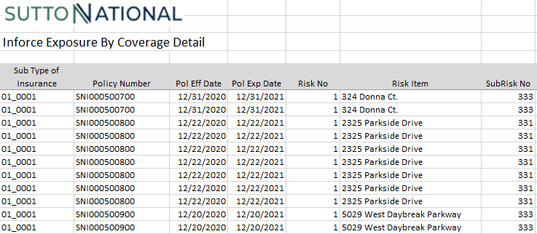
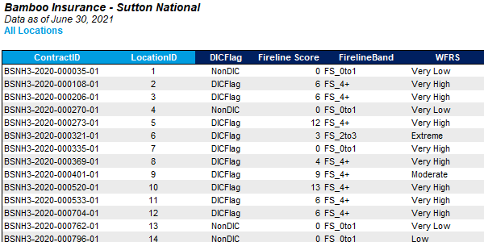
Raw Data – Different Shapes and Sizes
Raw data contents depends on
Data capture capabilities
Relevance
Client’s definitions
Most raw data will have
Policy / location info
Address info
Financial values
Location characteristics
User defined fields
Fields not used in models
Missing data
Important to capture as much data as possible
For this presentation, we will be using typical naming conventions – see later slides

Slide 12
Basic Policy Info
Policy Info is Usually Found in the First few Columns of Raw Data
Policy ID / policy name / contract ID
Identifier for a single policy
Usually a number, but can contain letters to differentiate types of policies
Location ID / location name
Identifier for a single location
Usually a number, but can contain letters to differentiate types of locations
Can have multiple locations for one policy
Inception date
Date the policy goes into effect
Expiration date
Date the policy expires
Typically one year after inception date
User ID / user text
Any additional information the client want to provide
Could be anything

Slide 13
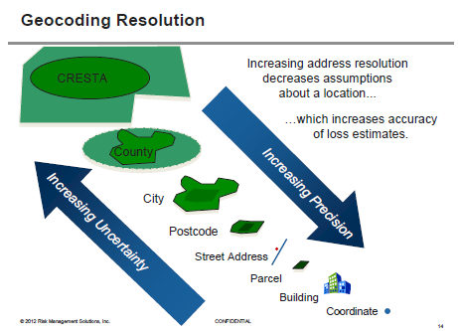
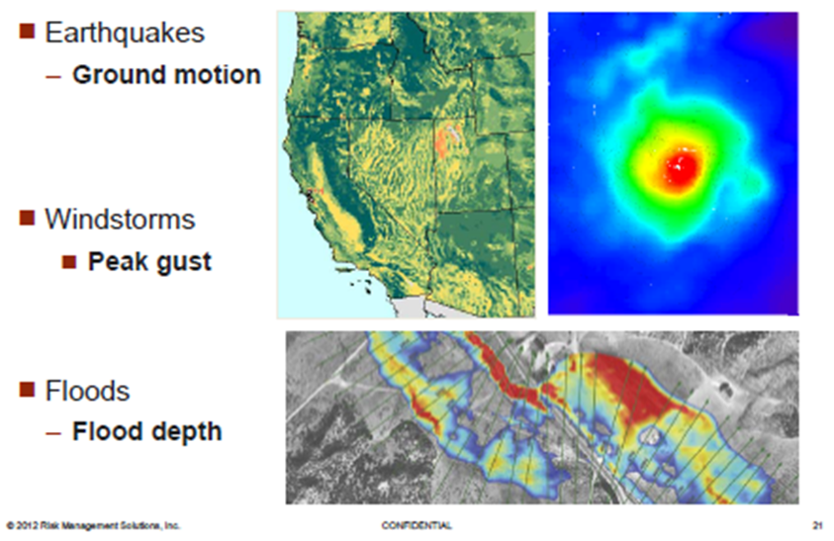
Geographic Data
Any Info that Tells Us Where the Risk is
Basic input information (lowest to highest resolution)
Country
State
County
Zip / Postal Code
Street Address
Latitude / Longitude
Translation process (Geocoding)
Address match information
Resolution issue by peril
Significance for modeling
Hazard lookup
Loss calculation issues
REQUIRED
(AIR and RMS)
REQUIRED
(RMS Only)

Slide 14
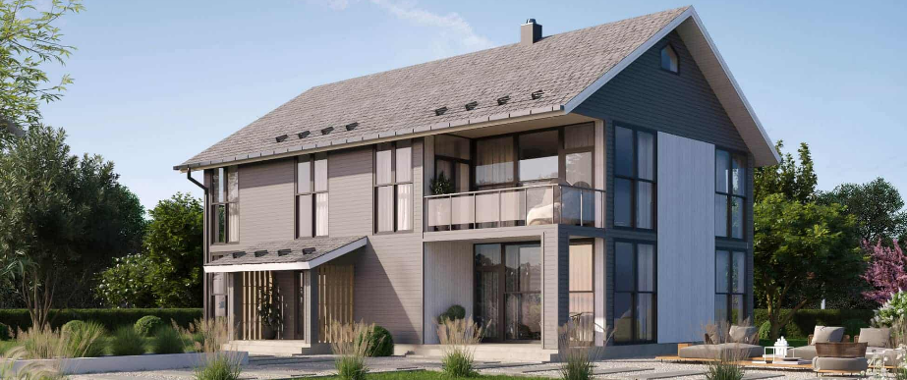
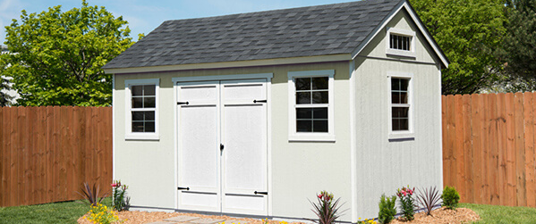


Financial Terms - Coverages
Important to Identify What Columns Apply to What Coverage
Policy Values
TIV
Coverage A – Buildings
Coverage B – Other Structures
Coverage C – Contents
Coverage D – Time Element / Business Interruption
Coverage E & F – Sometimes included but not used in the models
Policy Limits
Total Limit
Limit A – Buildings
Limit B – Other Structures
Limit C – Contents
Limit D – Time Element / Business Interruption
Limit E & F – Sometimes included but not used in the models
Premium
Not directly used by the models but is helpful to include
A
B
C
D

Slide 15
Financial Terms - Deductibles
It’s Important to Communicate with the Client to Accurately Represent Their Data in the Models
Deductibles
Can be a percent or a dollar amount
Can be used only for specified perils
If this is the case, it is typically split between wind deductibles and all other peril (AOP) deductibles
Can be applied to the entire location or specific coverages
The models will want you to specify deductible type
Example
Say a client supplies us the following columns for deductibles:
Hurricane_ded
Named_storm_ded
Wind_ded
Aop_ded
Which one should you use when building your hurricane portfolio? Earthquake? Convective storm?
In this scenario, the client wanted us to use a hierarchy – use one when the others were zero and do the same for the rest of the list.

Slide 16
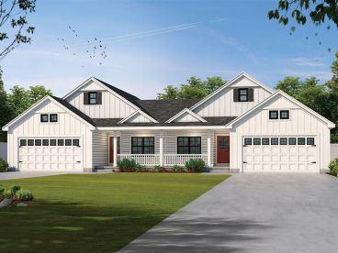
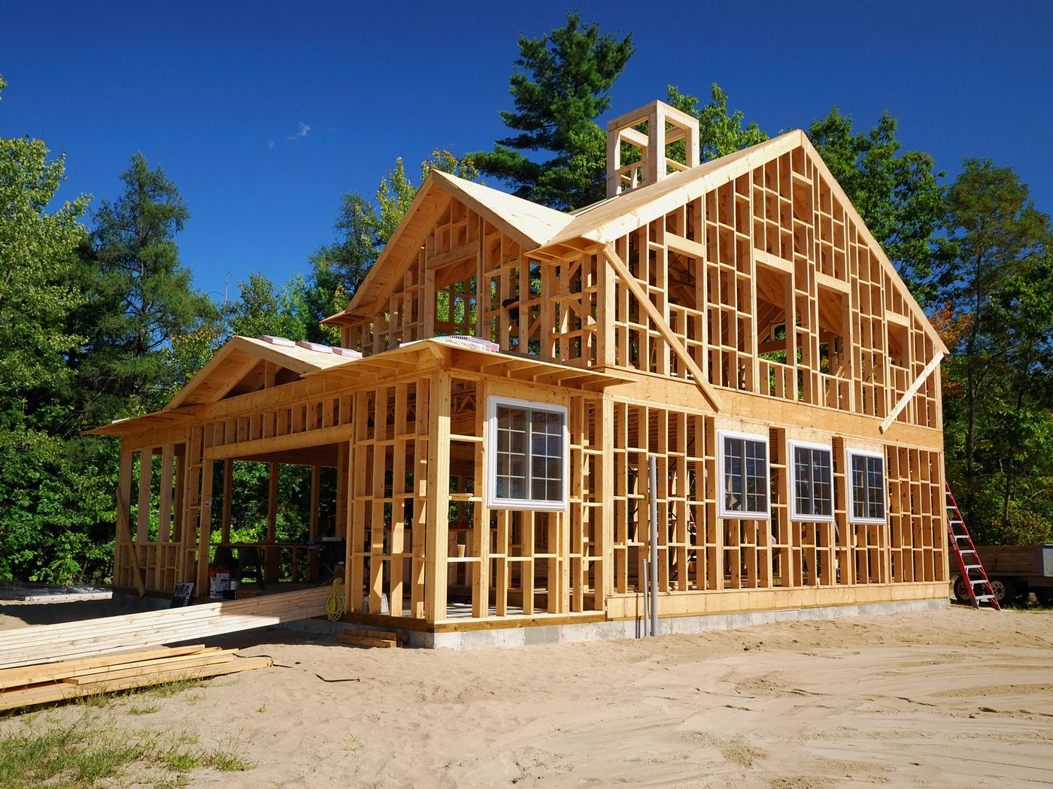
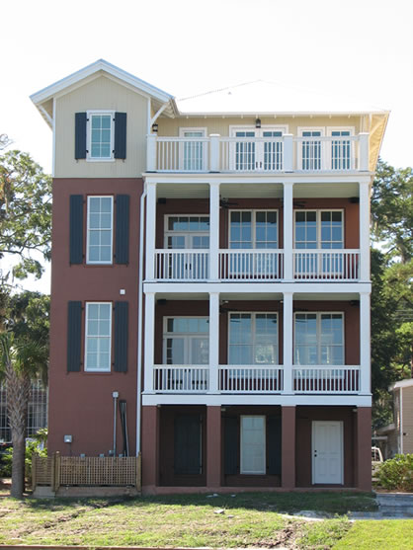
Primary Modifiers / Characteristics
The Models Will Need this Info in order to Run
Construction
What the structure is made of
Typically one of the following
Wood
Masonry
Metal
Concrete
Occupancy
What the structure is used for
Typically split between residential and commercial
Year built
Year the structure was built
Stories
Number of stories of the structure
Square Footage
Not actually necessary to include, but does play a reasonable factor

Slide 17
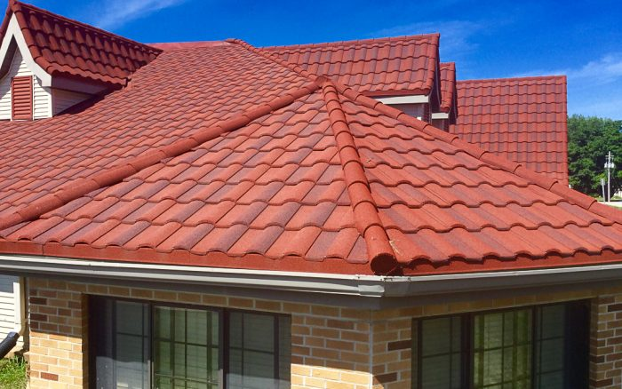
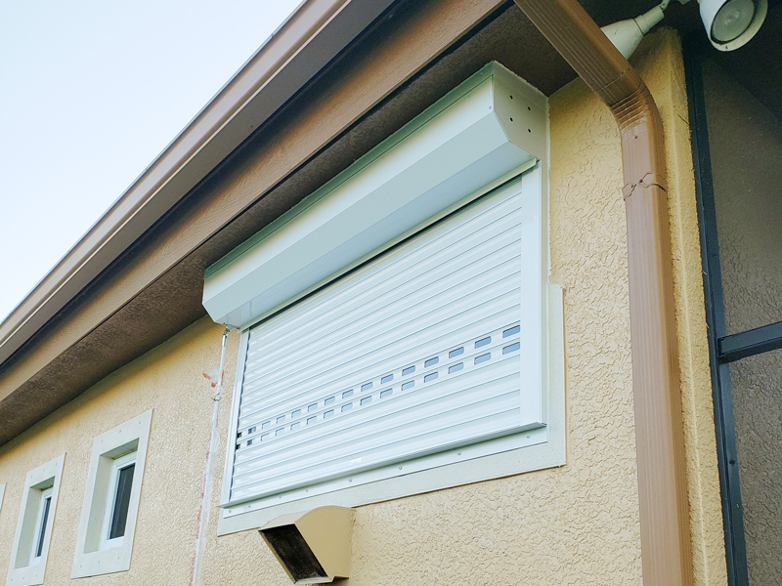
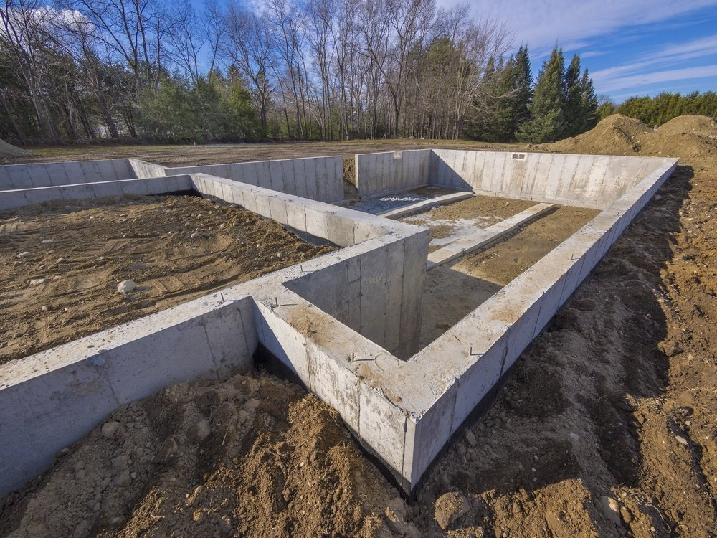
Secondary Modifiers / Characteristics
All Modifiers – Including Primary Ones – Will be Set to a Default Value (Usually Unknown) in Each Model
Secondary modifiers are characteristics outside of primary characteristics that affect losses
Most clients will only provide a few usable modifiers
Most important secondary modifiers for hurricane portfolios
Roof age
Roof material
Roof geometry
Siding type
Each model has documentation on what modifiers are captured for each peril
This will be provided when you reach the training sessions pertaining to each model
Secondary modifiers are only applied if primary modifiers are coded
General tip:
If you see something that might link to a modifier in the models, create an assumptions doc stating what column you’re looking at and what you think each entry should be mapped to

Slide 18
Example Policies
Policy 1 – Single Family Home:
$250,000
Policy 2 – Multiple Buildings:

Slide 19
Example Policies (cont.)
Policy 3 – Sublimits:
Policy 4 – Shared/ Layered Policy:

Slide 20

Example Policy with Loss
Coverage A:
$300,000
Coverage B:
$40,000
Coverage C:
$60,000
Coverage D:
$10,000
Deductible:
2% (of Coverage A)
Premium:
$750
Sample Event Details:
A tornado runs through the policyholder’s neighborhood, causing damage. The following claim is made.
Roof Repairs costing $20,000
Garage Repairs costing $1,000
Flooded Basement Damage costing $2,000
Other Building Damage totaling $60,000
Losses will depend on what kind of insurance the policyholder has
Is flood included?
Are there certain limits?
Ground-Up Loss (Assuming Everything is Covered)
$83,000 = $20,000 + $1,000 + $2,000 + $60,000
Gross Loss (Assuming Everything is Covered)
$77,000 = $83,000 - $6,000

Slide 21

Questions?

